Slide 1

An Explanatory Analysis of Global Covid-19 Crisis
Name: Hakeem Olla Abdussalam
Date: 30th September 2020

Slide 2
Table of Content
⁕ Objectives of the analysis
⁕ About the data
⁕ Methodology of the analysis
⁕ Result and insights
⁕ Conclusion

Slide 3
Objectives
Identify the distribution of confirmed cases, death and recovery across the globe and identify five countries with the highest number of confirmed cases and deaths. To also identify the rend of confirmed cases and death in Nigeria across the years.

Slide 4
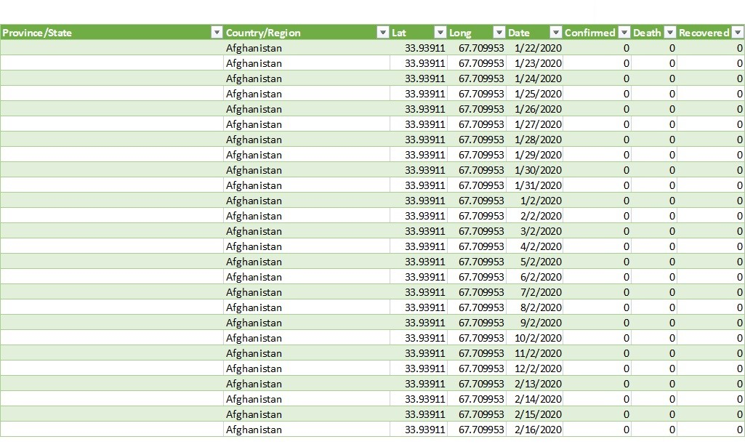
About the data
● The data is a time series that
is regularly updated
● The source of the data is
John Hopkin University USA
● The dataset used contains
confirmed cases, death and
recovery from all countries
between 2020 to 2022

Slide 5
Methodology
● The analysis was carried out with Microsoft excel
● The raw datasets were cleaned and merge with power query
● Calculations were done with help of Pivot tables
● Charts were used to visualize insights

Slide 6
Confirmed cases
● North and South America, Europe
and Asia have high number of
confirmed cases
● African countries has low number
of cases compare to other
countries outside Africa
● The total number of confirmed as
at the time the analysis of this
report was made is 602,769,643

Slide 7
Confirmed Cases by Year
● Then number of confirmed
cases continue to increase
every year
● There was 144% increase
in confirmed cases in
2020-2021 and 55.4%
increase from 2021-2022

Slide 8
Confirmed cases (Top 5)
● The United States of America
has the highest number of
confirmed cases in the world,
amounting to 16% of the
global confirmed cases
● India is seconds, followed by
Germany, France and Brazil
● The 5 countries accounts to
40.2% of the global cases

Slide 9
Death cases
● The North America, South
America, Europe and Asia
have high number of death
cases in the world.
● African countries has low number
of death compare to other
countries outside Africa
● The total number of death as the time this dataset of this report was acquired is 6,487,401

Slide 10
Confirm cases (Africa)
●Total number of confirmed cases in
Africa is 12,348,488 which is 2.05%
out of the total global cases
● The top 5 countries amount to
7,449,979, which is 60.3% of the
whole Africa
● South Africa is leading with total
number of 4,017,163, follow by
Morocco, Tunisia, Egypt and Libya

Slide 11
Confirmed cases (Nigeria)
● Nigeria record total confirmed cases
as 265,186 as at the time of this report
● In the year 2020, there was total
number of 87,607, while in 2021
the cases increse with 153,906
new cases and with 23,673 cases in
2022

Slide 12
Death cases (Nigeria)
● Nigeria record total confirmed
cases as 3,155 as at the time of
this report
● In the year 2020, there was total
number of 1,289, while in 2021
the cases increases with 1,741
new cases and with 125 cases
in 2022

Slide 13
Death Rate
● While the number of death
cases increases from 2020
2021, there was decrease in it rate
from 2.27% to 1.75%
● The decline continue in 2022,
dropped further to 0.93%
● The increase vaccination and
much sensitization could aid this,
however the data acquired for this
report is not enough for this claim,
just an assumption

Slide 14
Conclusion
● It is evident from the analysis that Covid-19 is still much around as
the number of cases keep increasing
● People should be more careful and observe Covid-19 precautionary
measures
● There should be a continued vaccination drive to protect people and
lower the spread of the virus

Slide 15
